Slide 1
111-2 六年級 英文科 課程計畫
連偉蓉

Slide 2
課 程 設 計
增進 英文 聽 說 讀 寫 4能力

Slide 3
教 學 計 畫
Teacher Whitney
Ms. Lien
繪本
每週一節
讀者劇場
課本
每週二節
單字句型小考

Slide 4
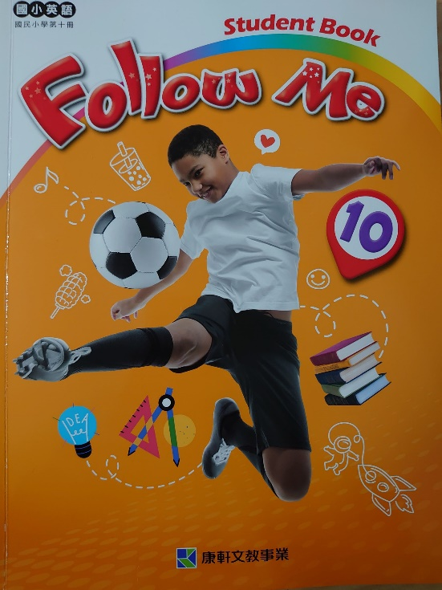
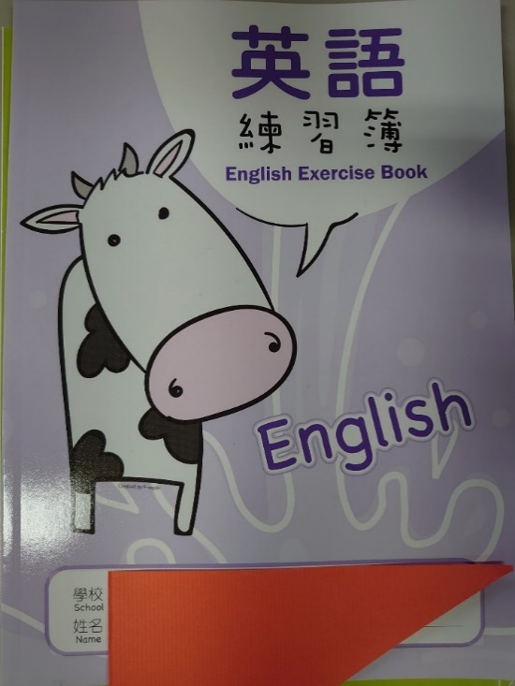
教 材 與 簿 本

Slide 5
繪本教學 & 讀者劇場
聽 說 讀 寫

Slide 6
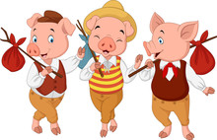
繪本 1
繪本 2
認識
讀者劇場
故事改編
票選劇本
劇本演練
正釋出演
6/14

Slide 7
評 量 方 式
聽力
口說
表現
小考作業
多 元 評 量
60%
紙 筆 評 量
40%

Slide 8
紙 筆 評 量
第一次評量
日期: 4/21
範圍: Unit 1 + Unit 2
Unit 4 * (部分)
第二次評量
日期: 6/2
範圍: Unit 3
Unit 4 * (部分)

Slide 9
小考單字句型
2023 六下單字句型表
考試日 | 單字 | 句型
2/24 | Germany Taiwan India Mexico | What is the most famous food in Japan?
3/3 | curry sushi tacos sausages | Stinky tofu is my favorite food.
3/10 | fish and chips invite tennis | Would you like to try some tacos?
3/17 | badminton volleyball soccer | What sports do you like to play?
3/24 | baseball basketball table tennis | Do you like to play dodge ball?
3/31 | ice hockey almost must often | Let’s play golf together next weekend.
4/7 | actor actress chef dentist | What do you want to be when you grow up?
4/14 | engineer singer mail carrier | Do you want to be a scientist when you grow up?
4/28 | bus driver police officer nurse | She goes out with friends on Sundays.
5/5 | rock star choices musician | He is going to see a movie next weekend.
5/12 | have a haircut have a picnic | What are you going to do tomorrow?
5/19 | stay at home take a trip | I’m going to visit my grandparents.
5/26 | study in the library have a party | Are you going to go mountain climbing next Saturday?
週五

Slide 10
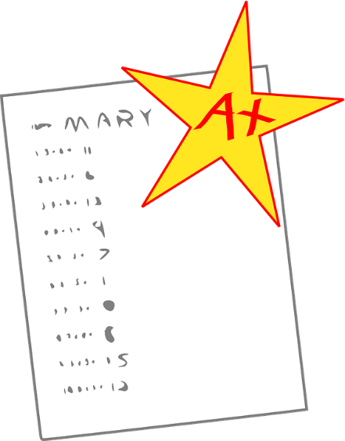
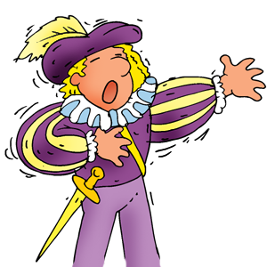
重 要 記 事
期中考: 4/21
畢業考: 6/2
讀者劇場: 6/14
每週五小考

Slide 11
Class 602 Speaking Test 2 Conversation

Slide 12
Thank you!
Room: 117 Ext. 817

